Slide 1
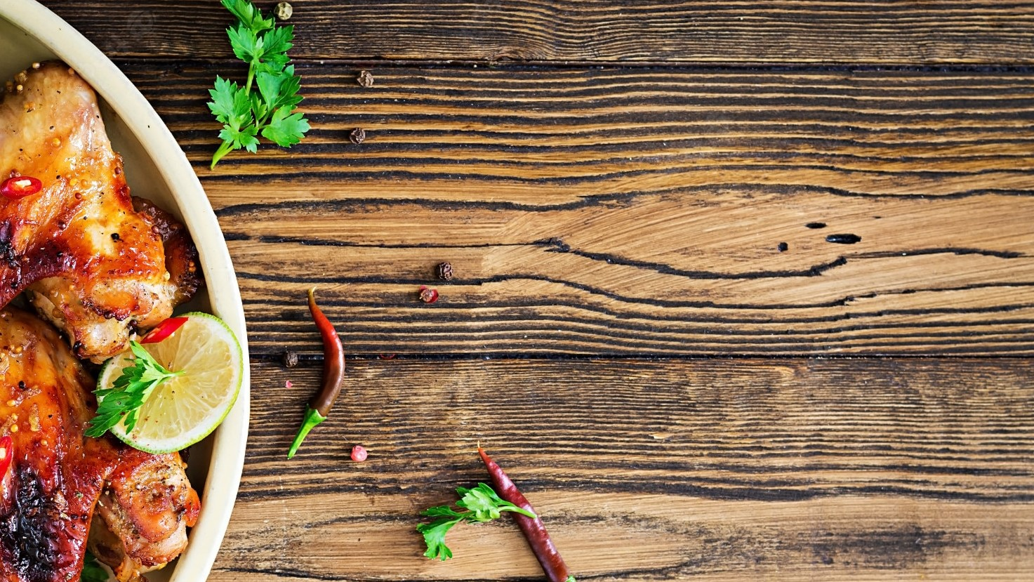
DINEEAZY
Varun Patakrod (229231)
Ninad Raut (229177)

Slide 2
Introduction
User can login into the web-application and search the restaurant according to the user location. Different restaurants’ information is shown to the user with the live status of the restaurant tables. The user can book the table from the application, pre-order the food stuff and make the payment through application.
The hotel owner is provided an interface through which he/she manages the order of the customer and also update the dynamic menu of the restaurant.
The customer order details are shown on the kitchen display desktop and staff serves the order when the customer arrives.
Every table of the restaurant has a tablet which works as a digital menu card. The user can directly order the food from tablet available on the table and make the payment.

Slide 3
Objective
The objective of the project is to make an application on a web platform to book tables at restaurants. In order to build such an application, complete web support needs to be provided. A complete and efficient web application that can provide an online restaurant table booking experience is the basic objective of the project.

Slide 4
Scope
We are proposing this above titled web application that will help customers to save time and make it a more memorable experience. Online reservation platforms primarily provide a platform that allows people to make online table reservations at their favourite restaurants in a seamless & hassle-free manner. Diners can choose a restaurant based on location, day, timing, cuisine and number of guests. Apart from this core feature, the web application also maintains restaurant listing with ratings, reviews, ambience and menus to help out diners in deciding the right dining outing as per their specific taste. The owners can also add their restaurant on the web application. Putting restaurant online will increase profit and helps to create an unforgettable brand for owner's restaurant.

Slide 5
Technology
ReactJS
Spring Boot
MySQL
GitHub

Slide 6
Software configuration
Chrome Browser

Slide 7
Hardware configuration
Processor :11th Gen Intel(R) Core(TM) i5-11300H @ 3.10GHz 3.11 GHz
Installed RAM : 8.00 GB (7.75 GB usable)
System type : 64-bit operating system, x64-based processor

Slide 8
functionalities
Customer : Once the customers log in with valid credentials, they can go through various restaurants options according to their location and in the cuisines interested. Diner can filter out restaurants through various quick filters. After choosing restaurant they can do reservation process that will be depending upon the following factors: Day, Time slots, No of guest, Availability. Once the booking request is accepted by restaurant executive/manager, the diner can shift to the payments where they can do payments via different modes of payment. Once the payment transaction will become confirmed the customer will get a receipt/invoice of the same.

Slide 9
Restaurant Owner : The newly interested restaurant owner can add his/her restaurant to web application, this will provide them a web platform to grow. In this modules the owner have to provide all details at the given portal and once their request is approved by the application management team, their request will be reflected to application.

Slide 10
Database design
Databases are the storehouses of data used in the software systems. The data is stored in tables inside the database. Several tables are created for the manipulation of the data for the system. Two essential settings for a database are
Primary key - the field that is unique for all the record occurrences
Foreign key - the field used to set relation between tables
Normalization is a technique to avoid redundancy in the tables.

Slide 11
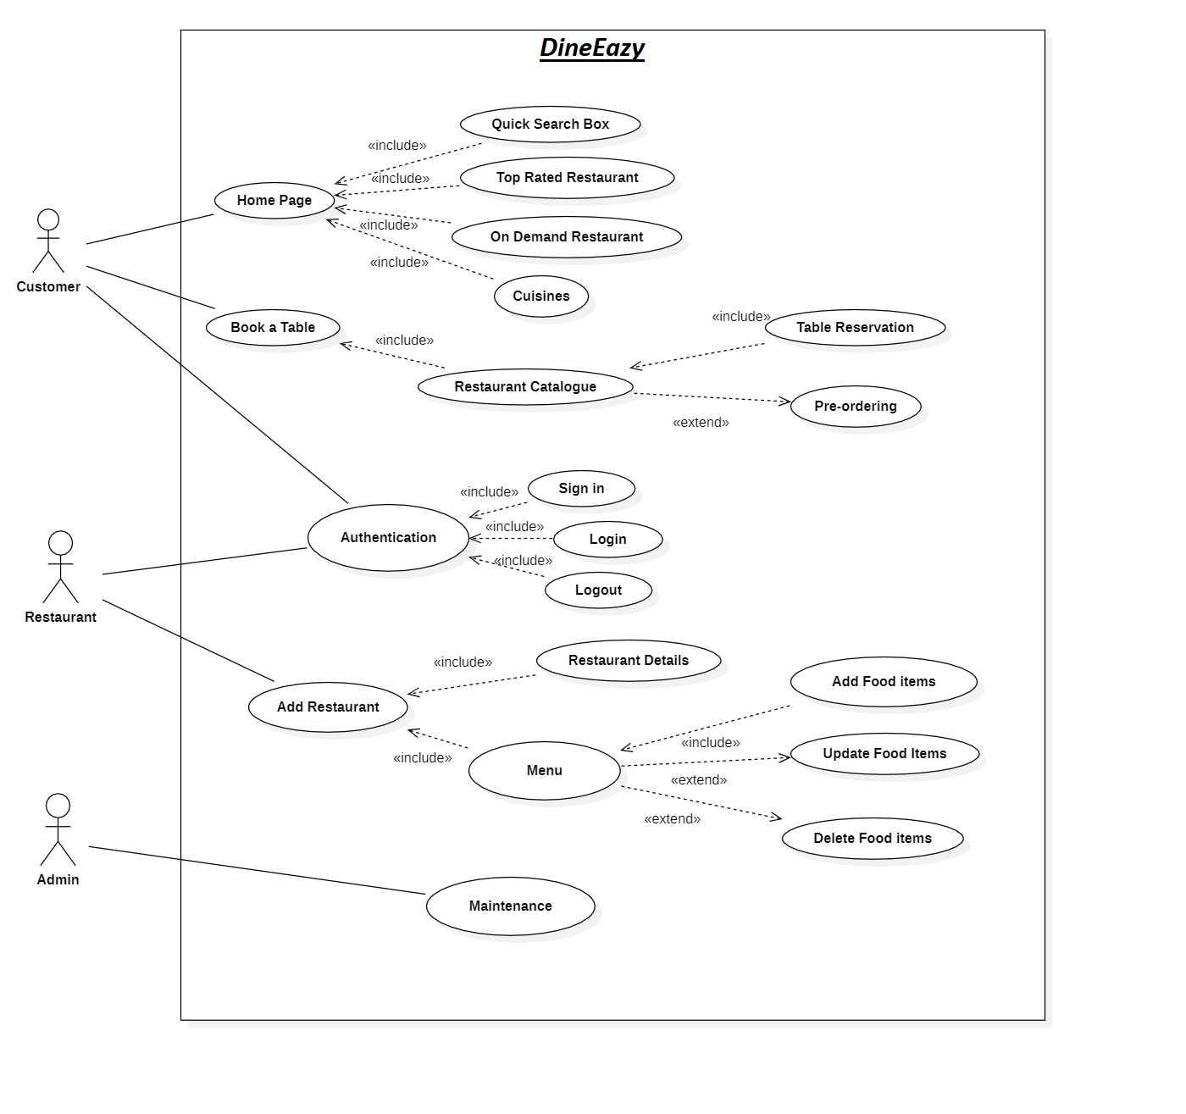
Use case Diagram

Slide 12
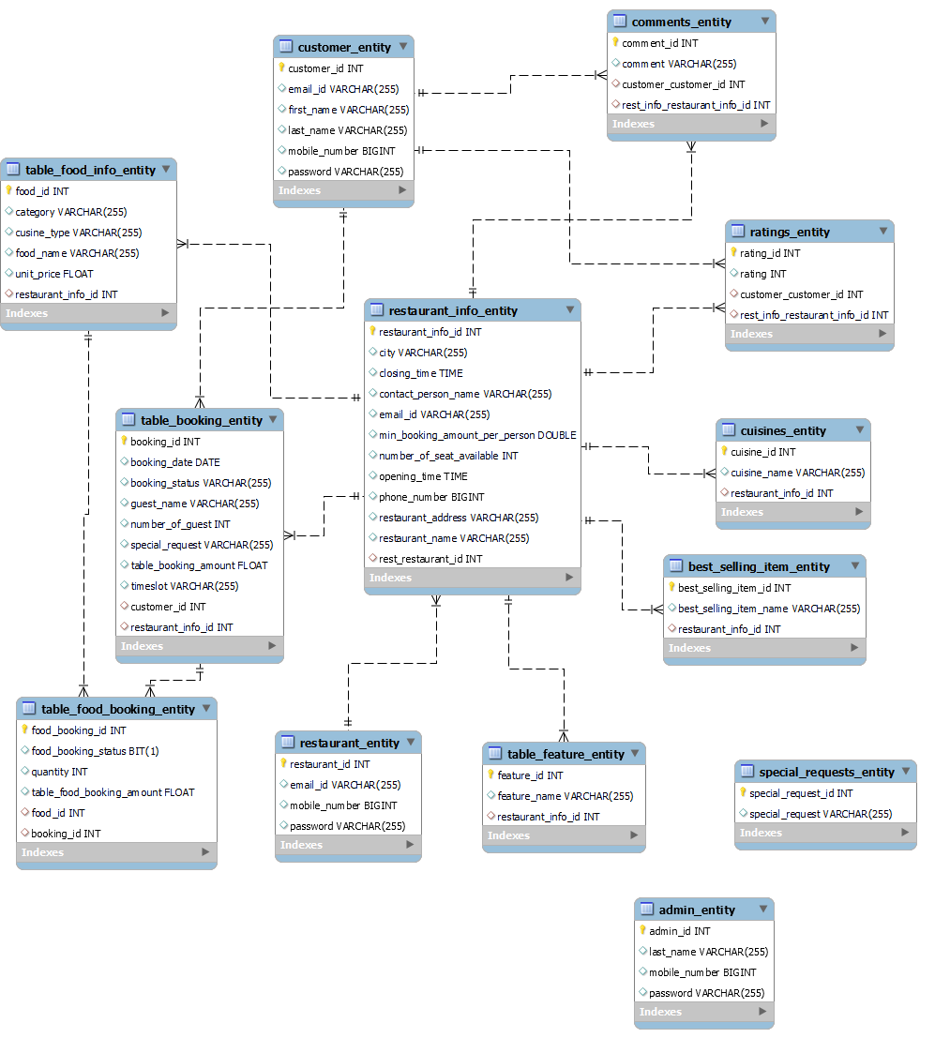
ER diagram

Slide 13
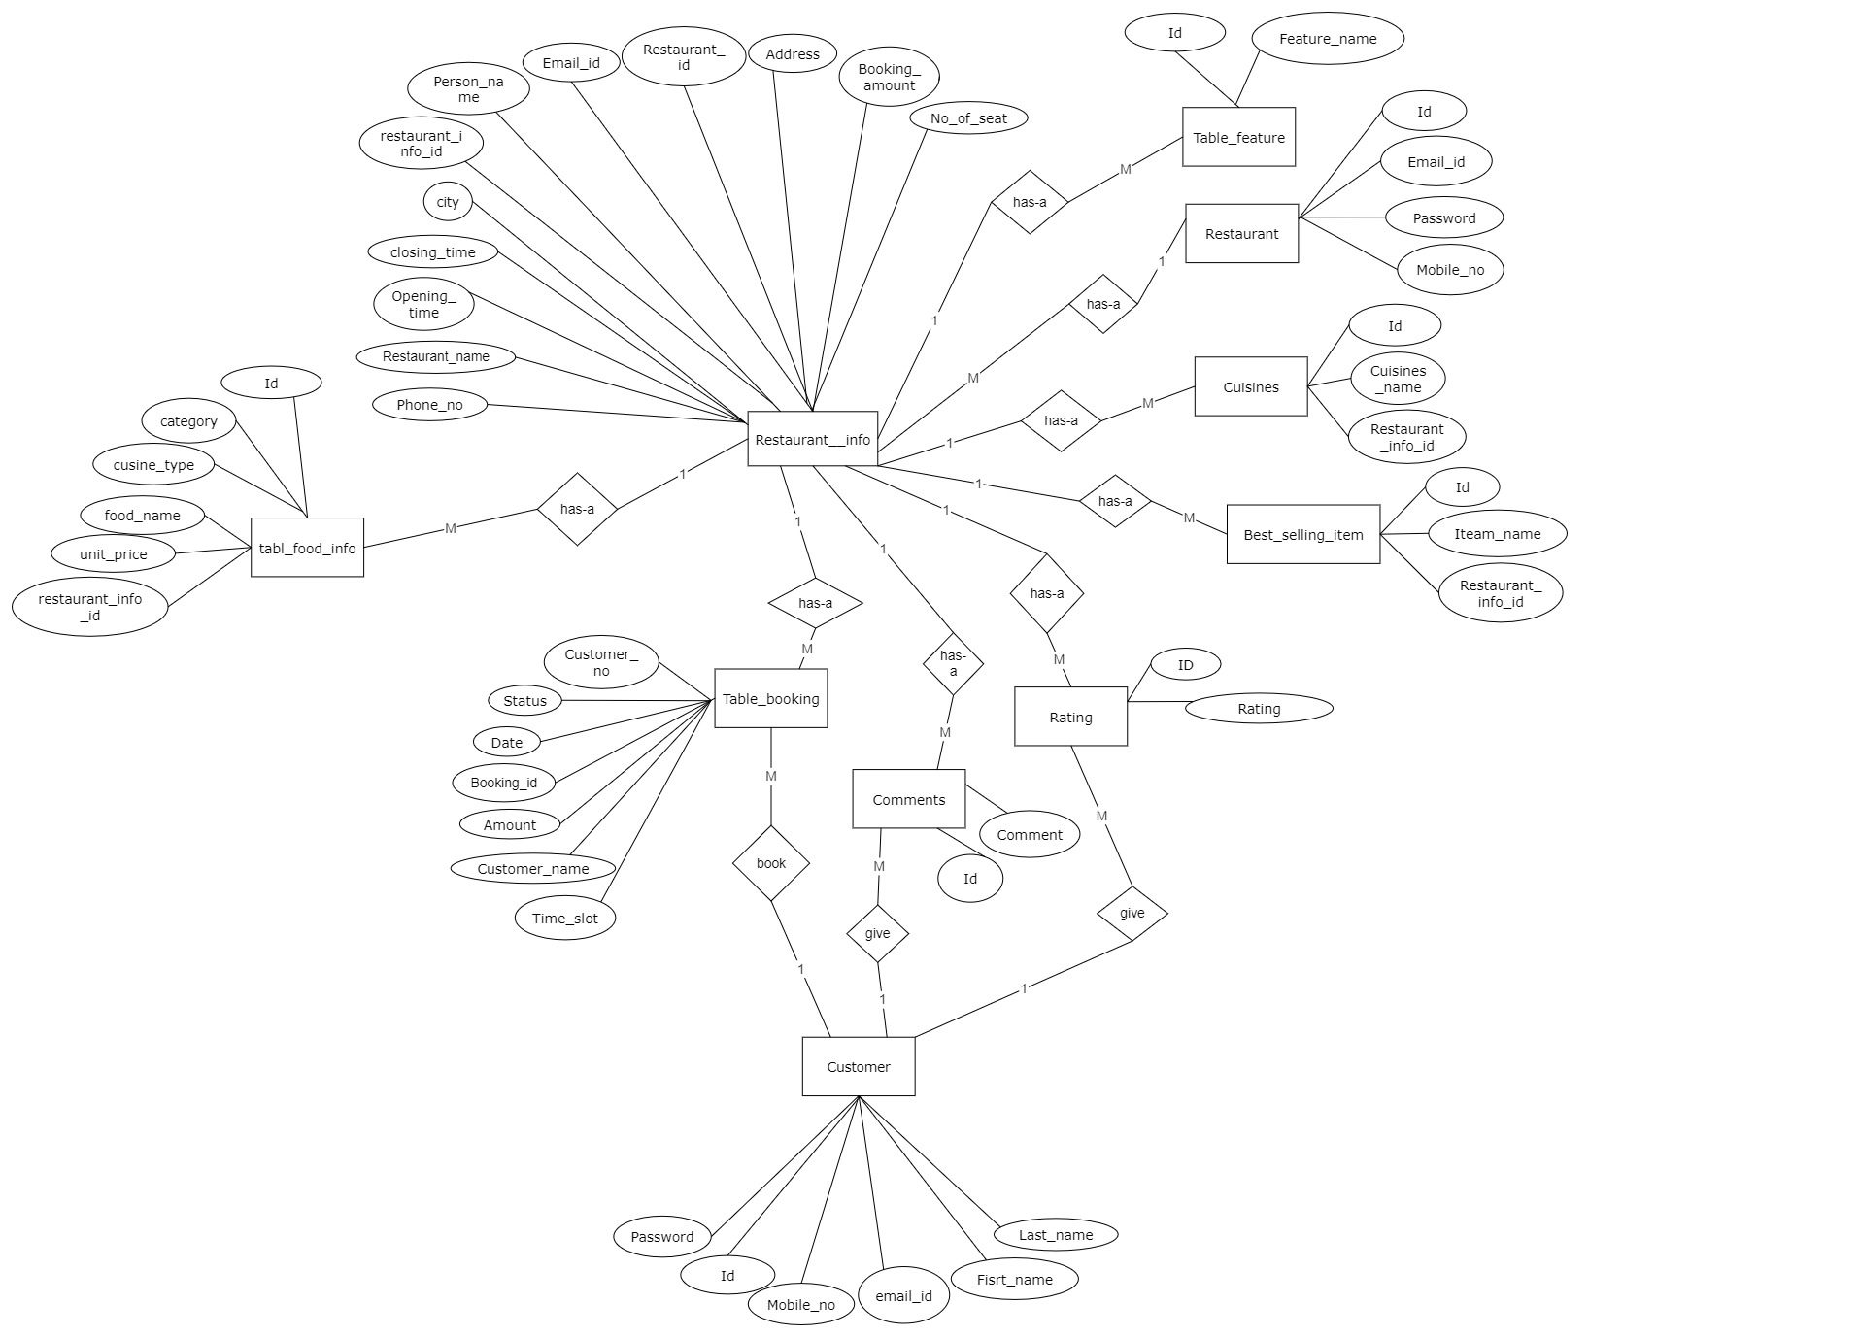

Slide 14
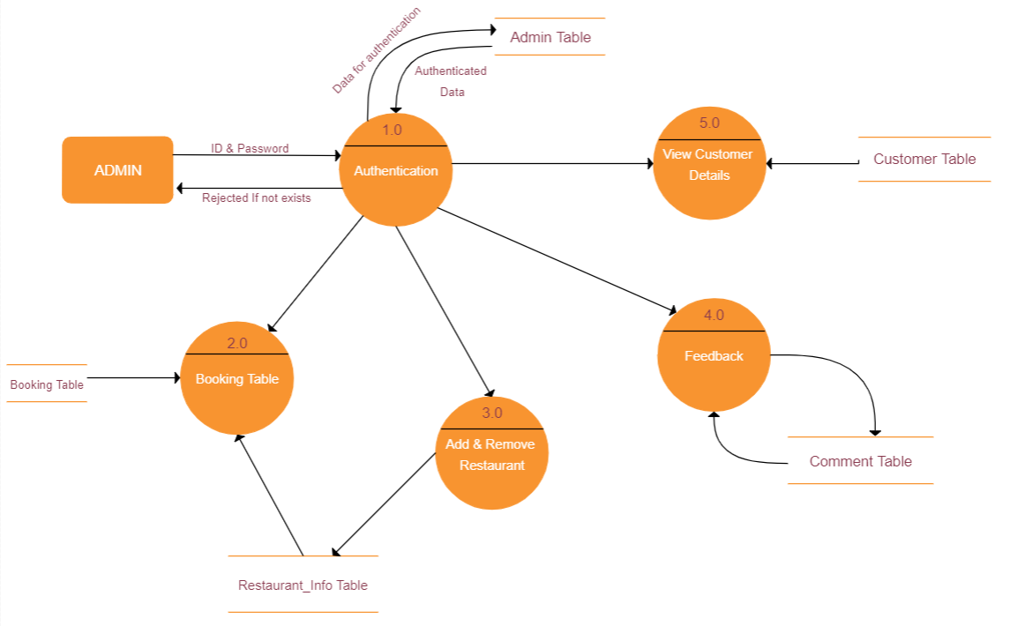
Data flow diagram

Slide 15
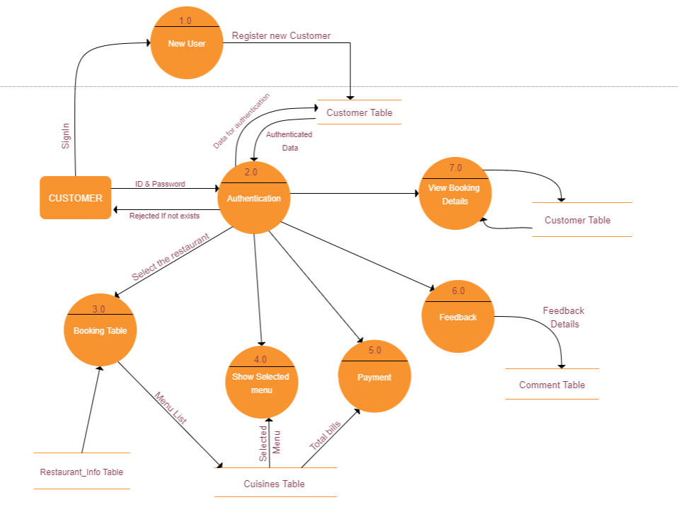

Slide 16
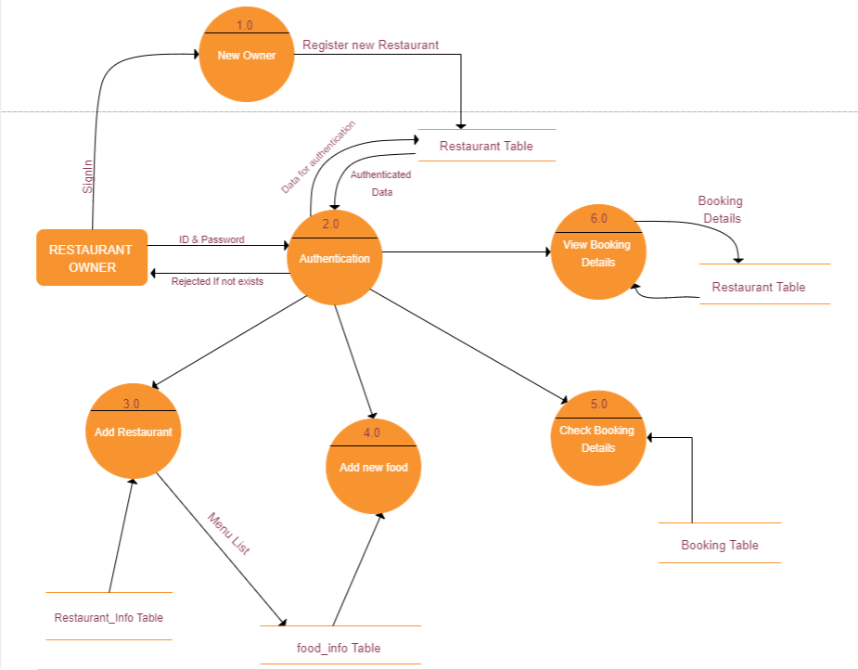

Slide 17
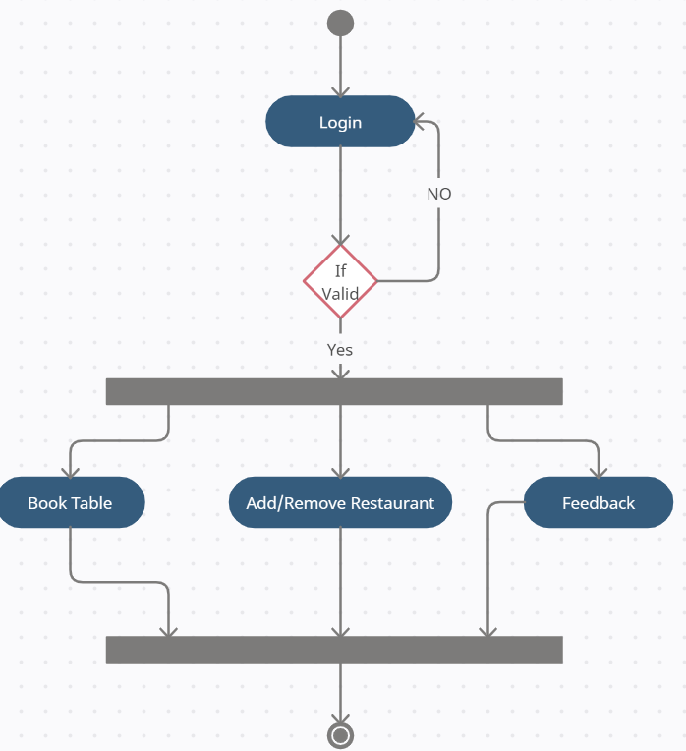
Activity diagram

Slide 18
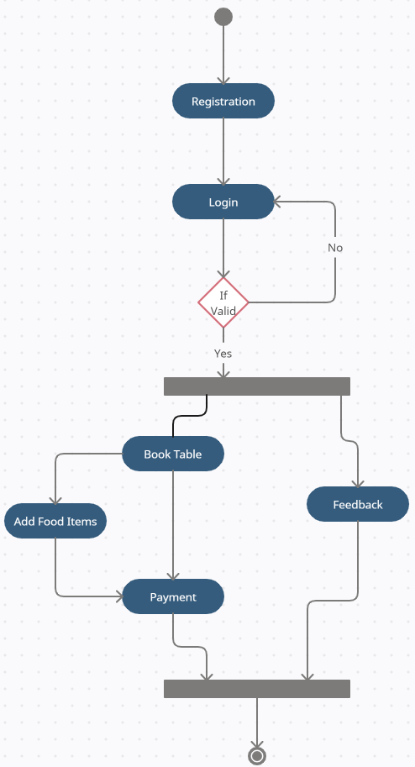

Slide 19
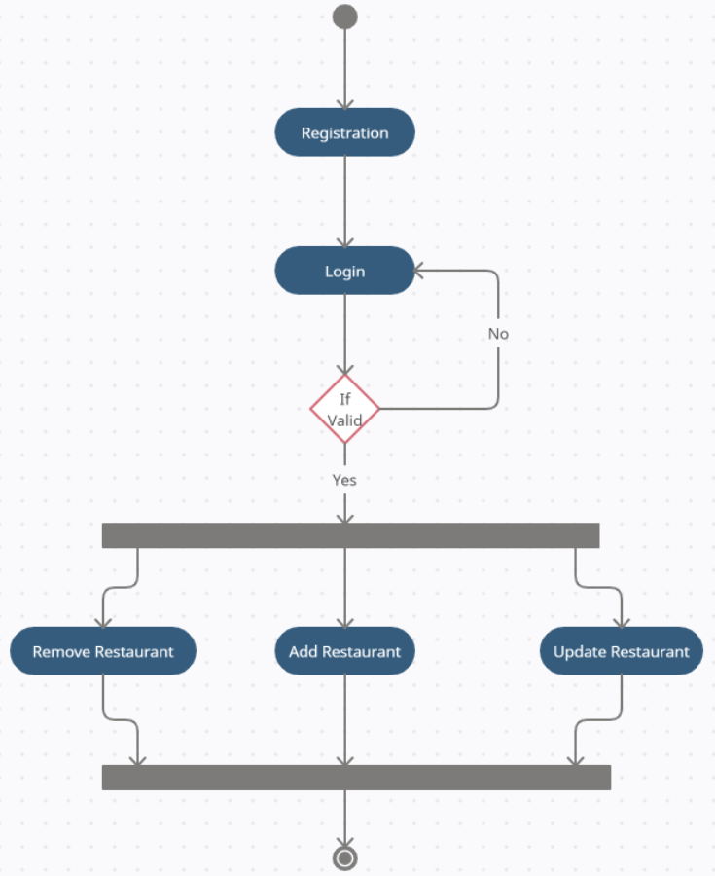

Slide 20
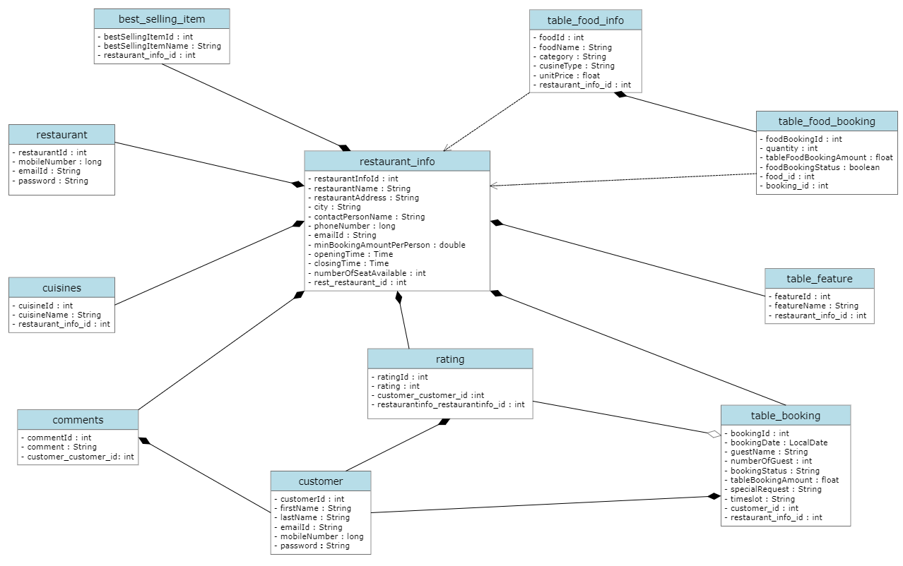
Class diagram

Slide 21
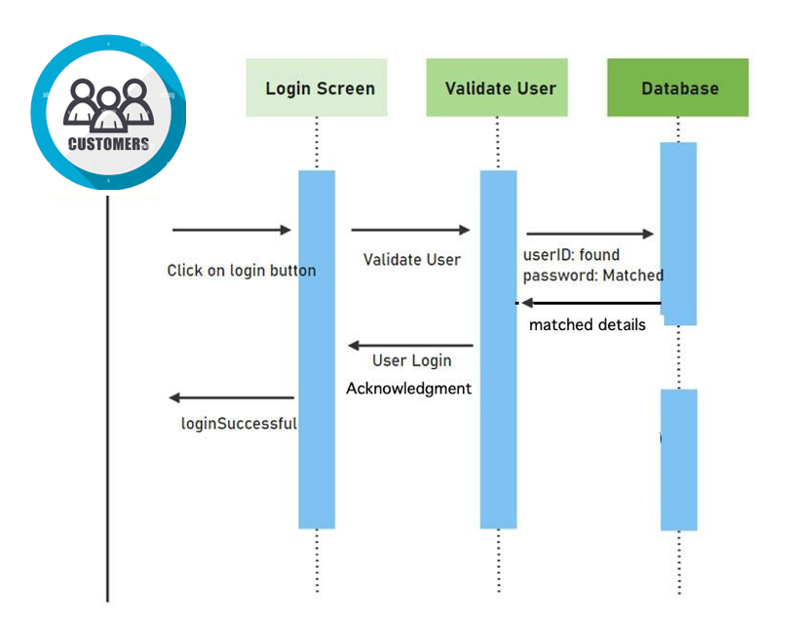
Sequence diagram

Slide 22
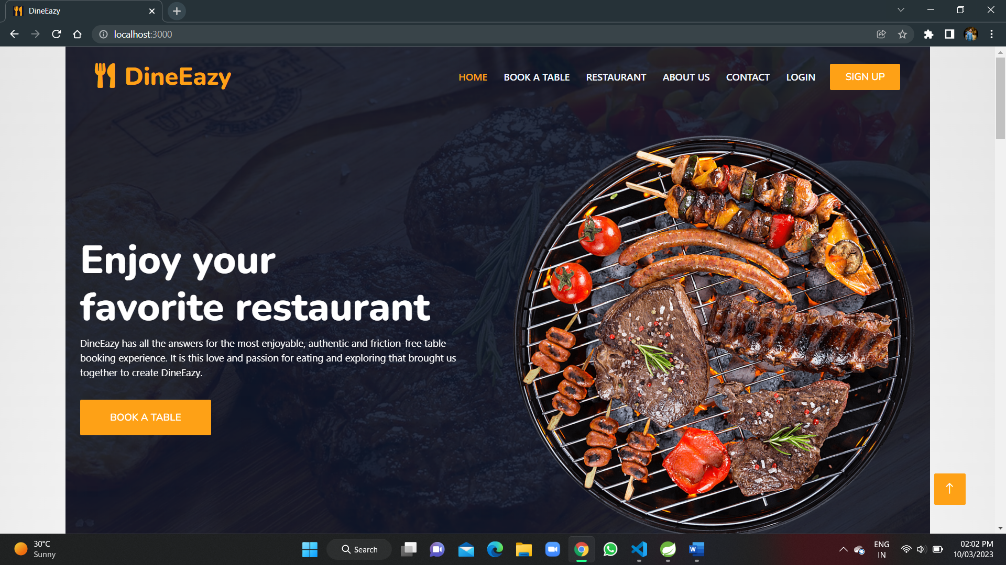

Slide 23
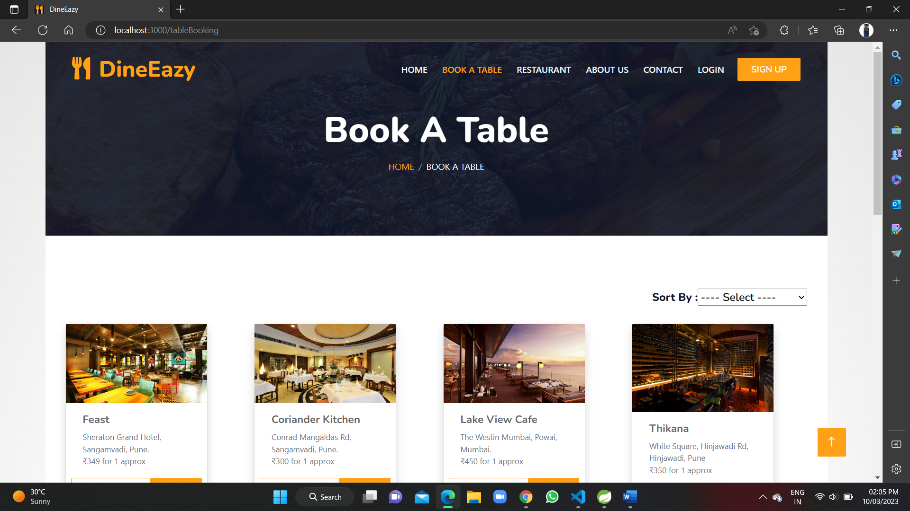

Slide 24
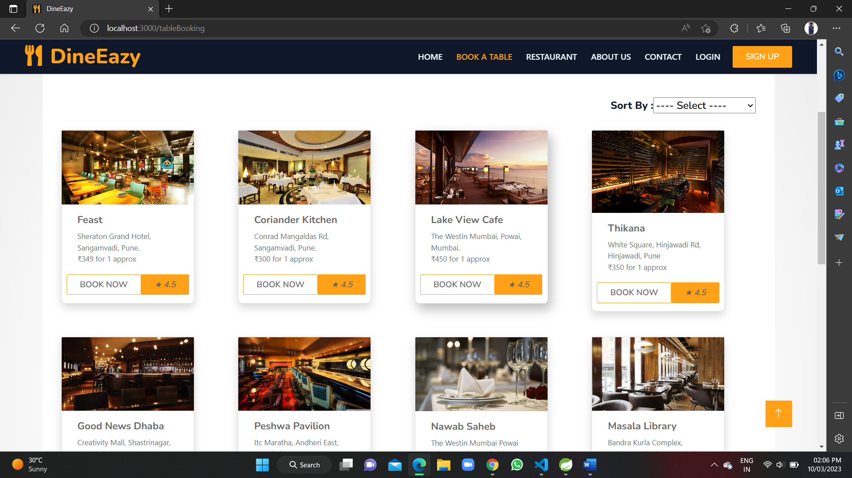

Slide 25
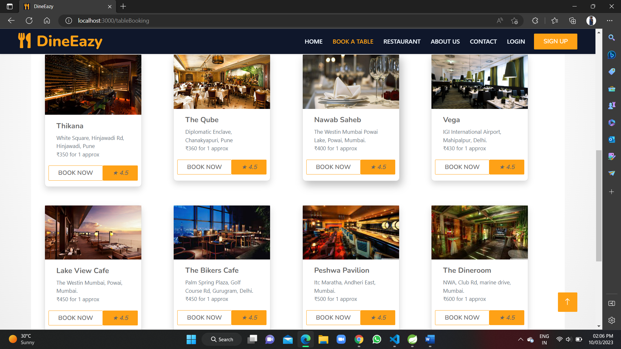

Slide 26
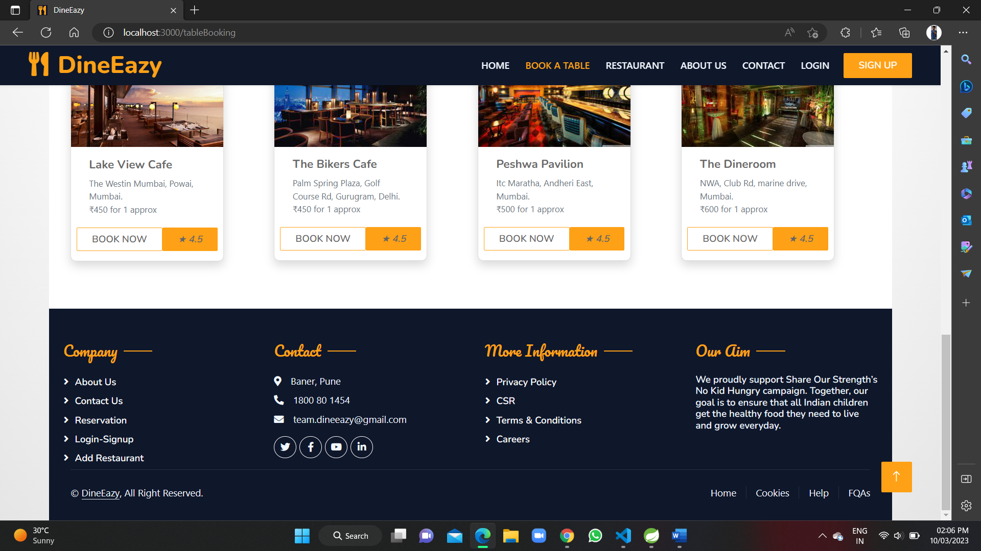

Slide 27
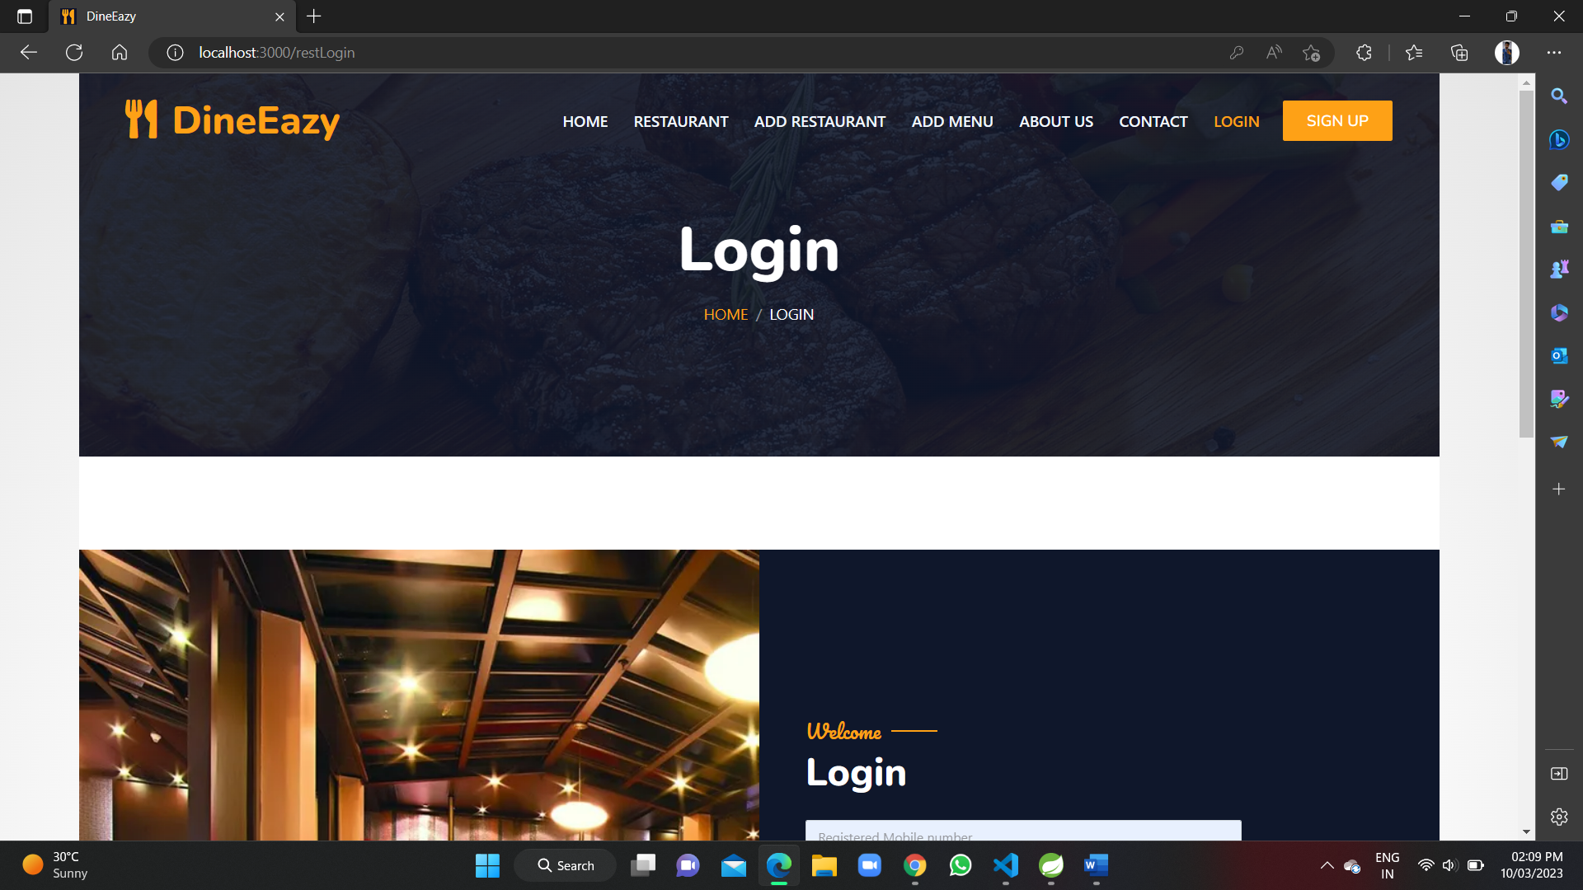

Slide 28
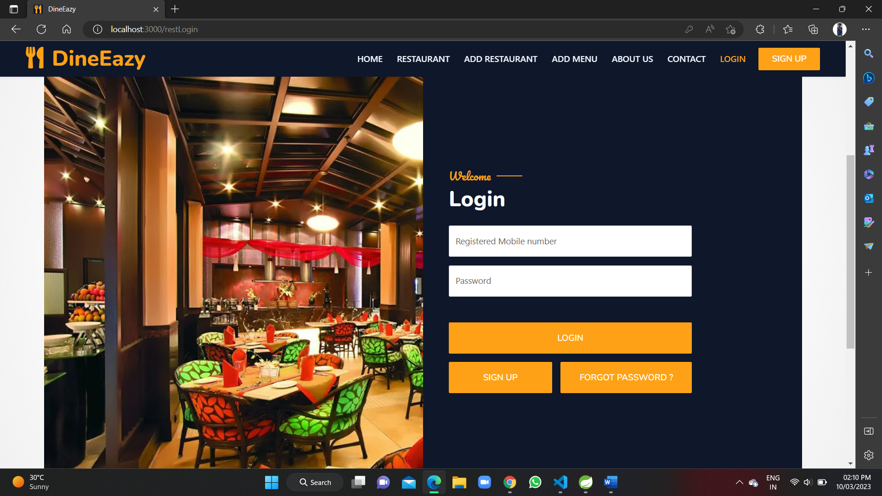

Slide 29
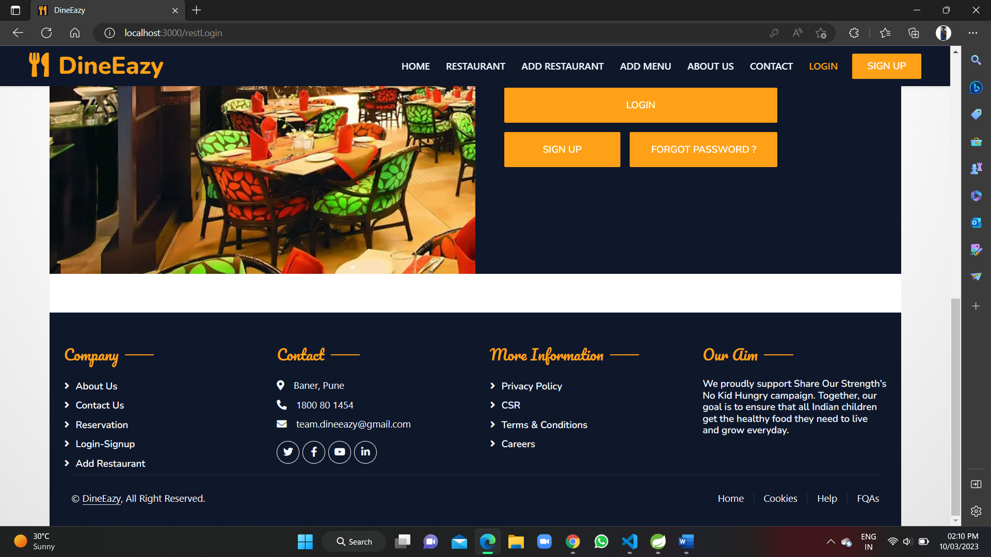

Slide 30
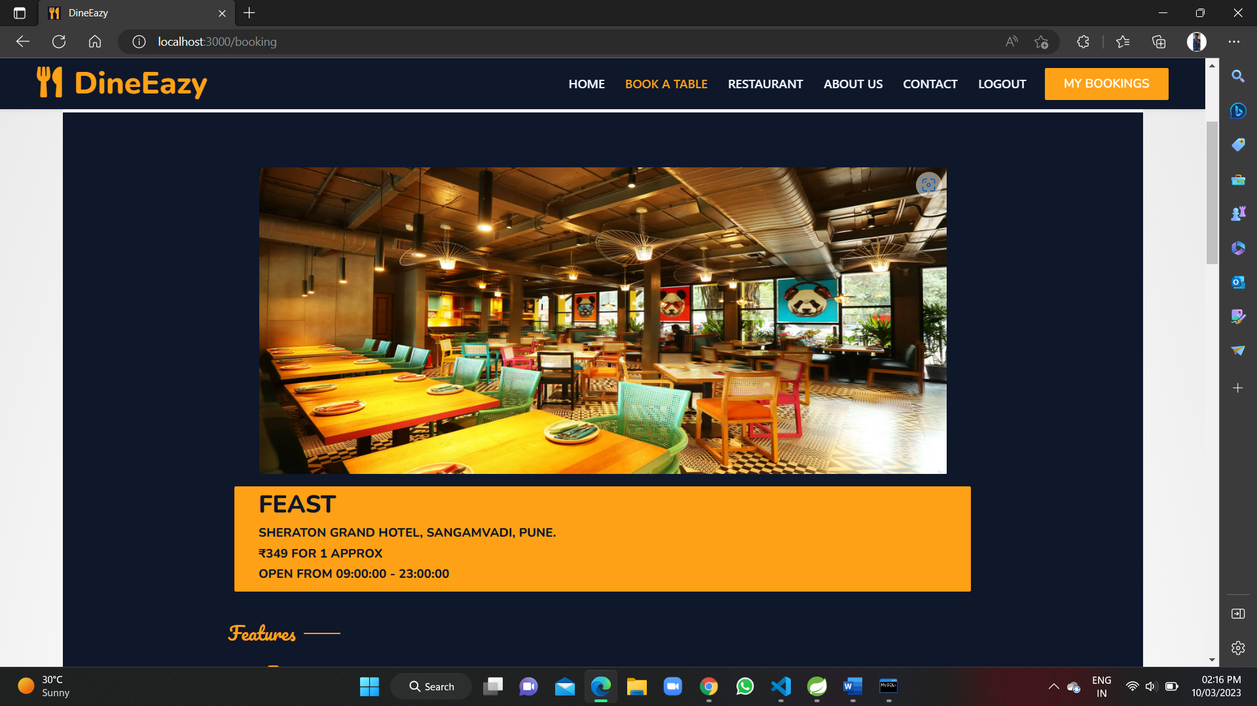

Slide 31
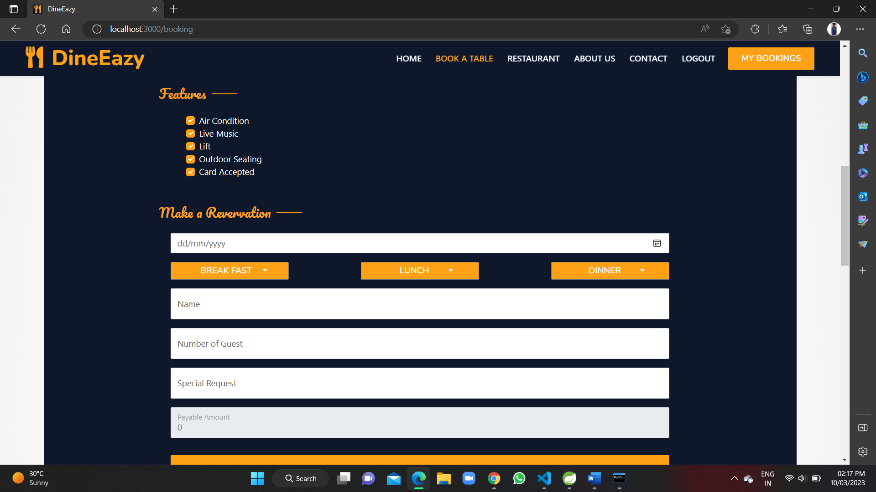

Slide 32
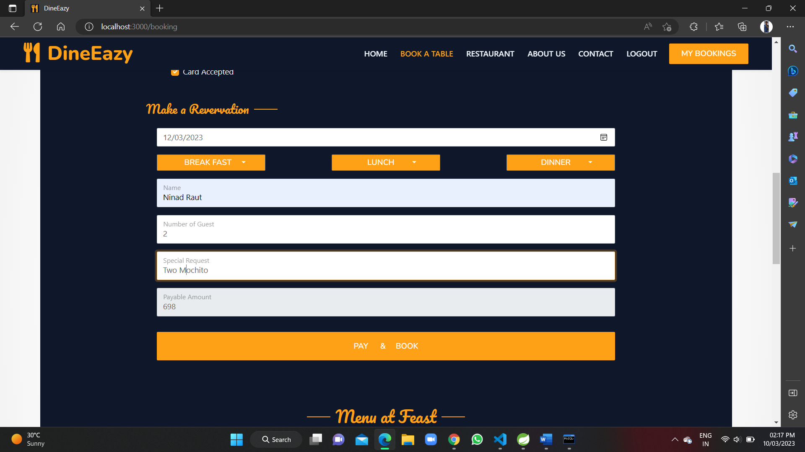

Slide 33
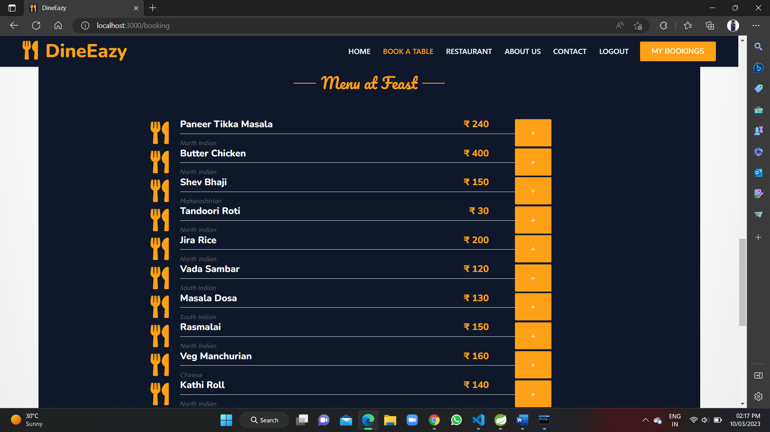

Slide 34
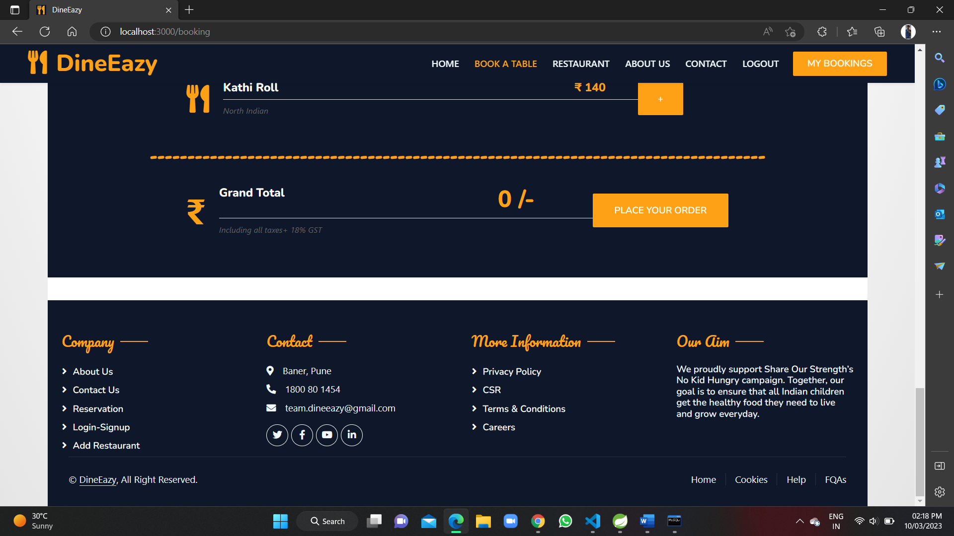

Slide 35
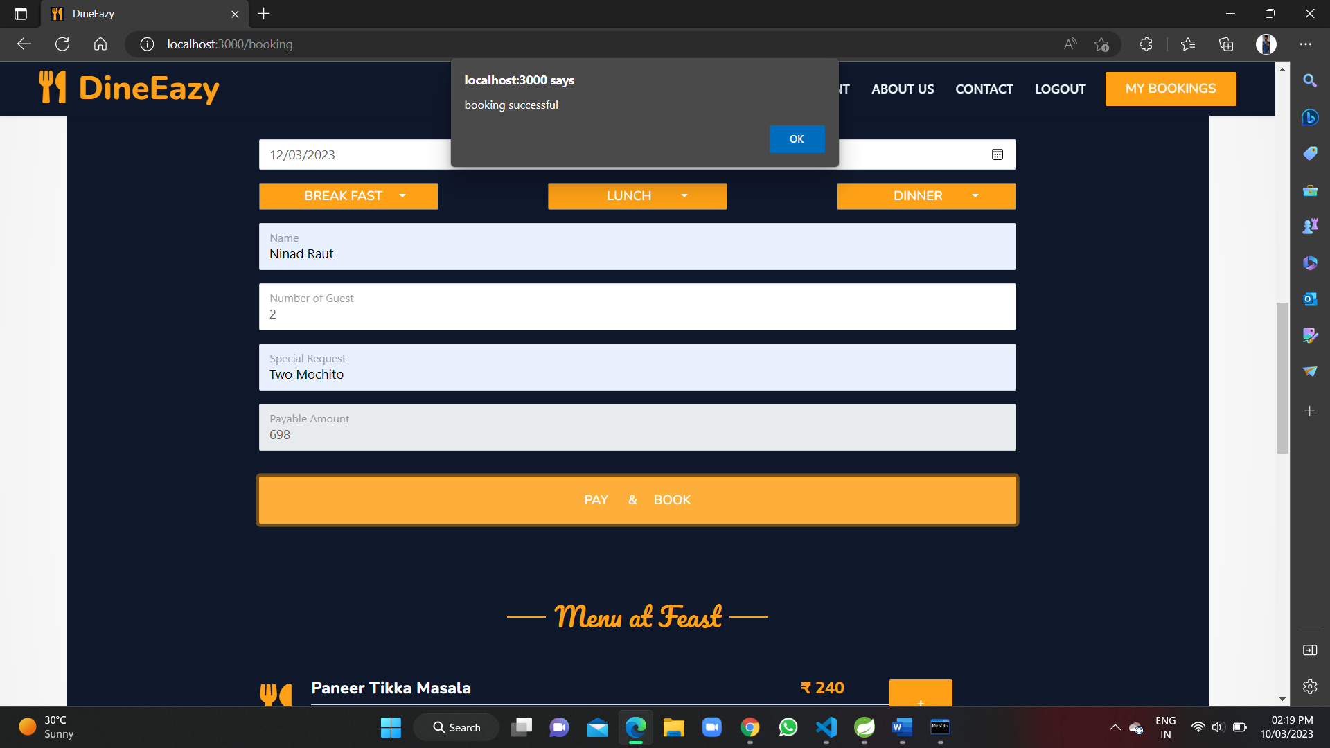

Slide 36
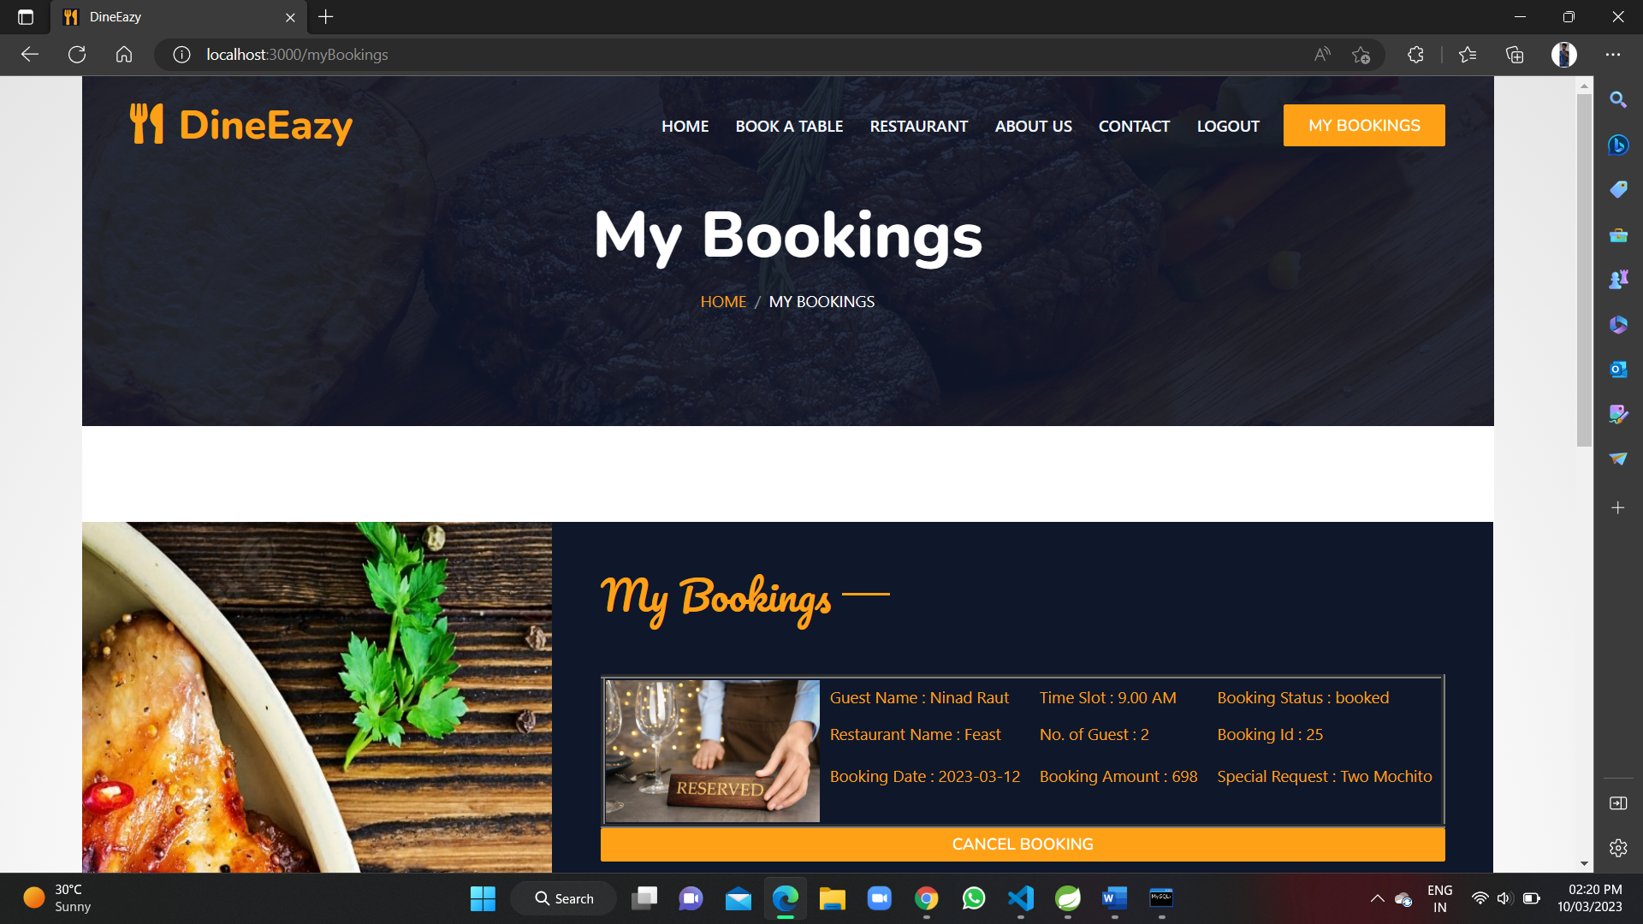

Slide 37
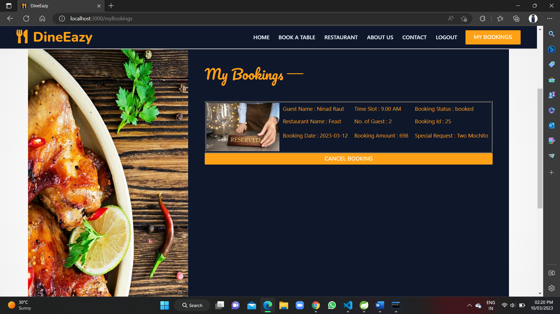

Slide 38
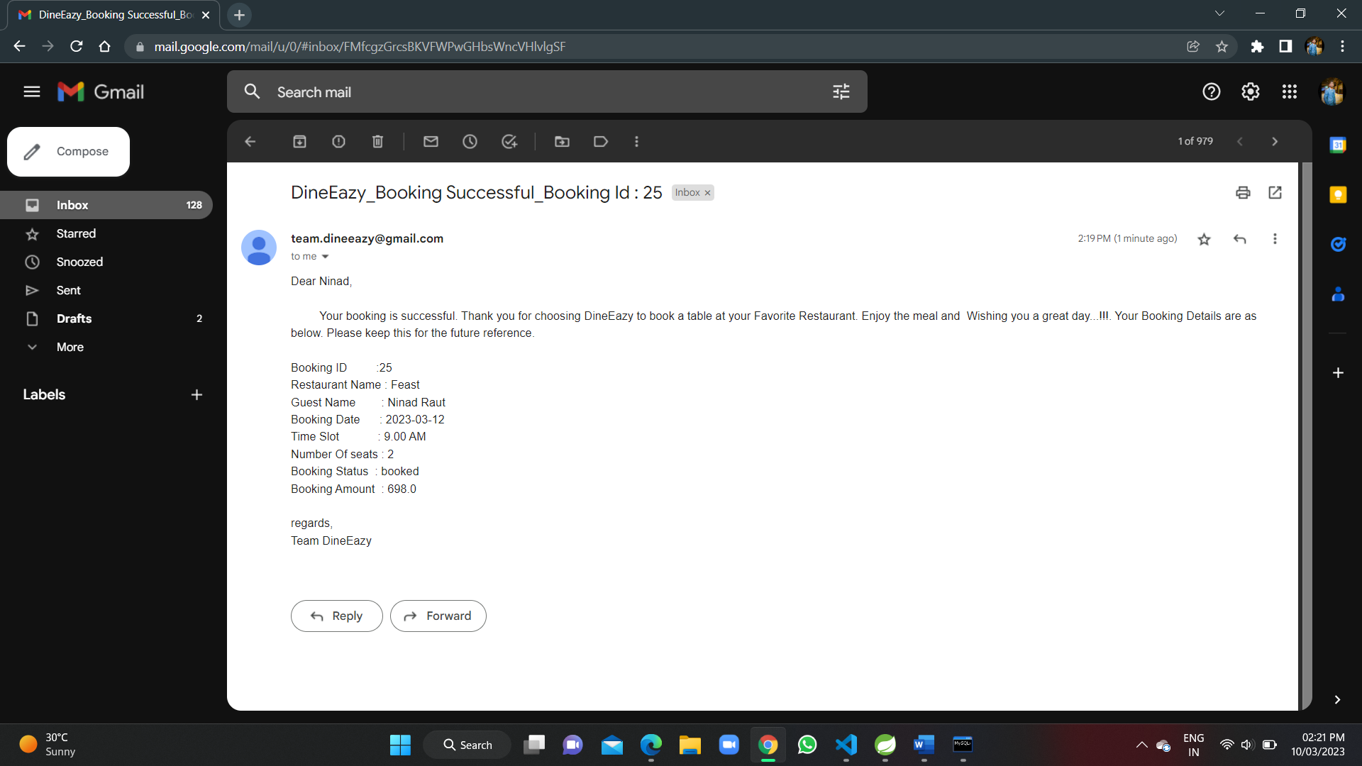

Slide 39
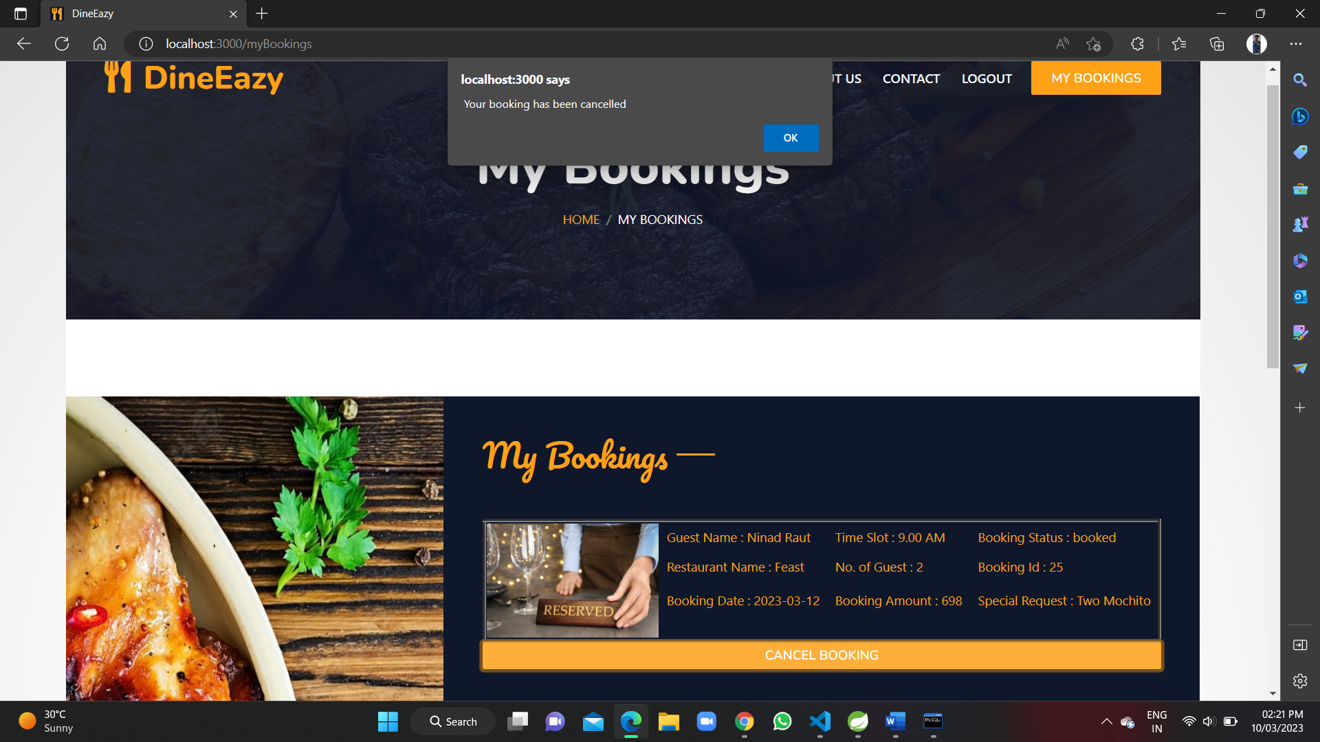

Slide 40
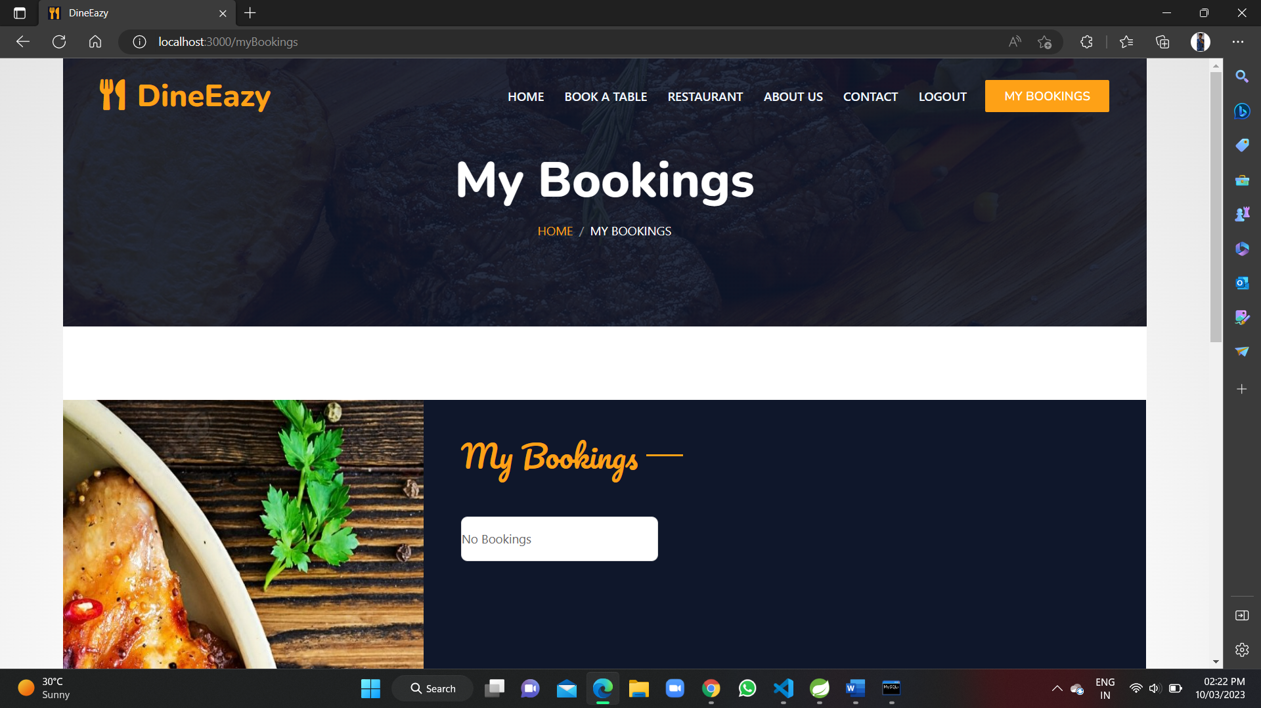

Slide 41
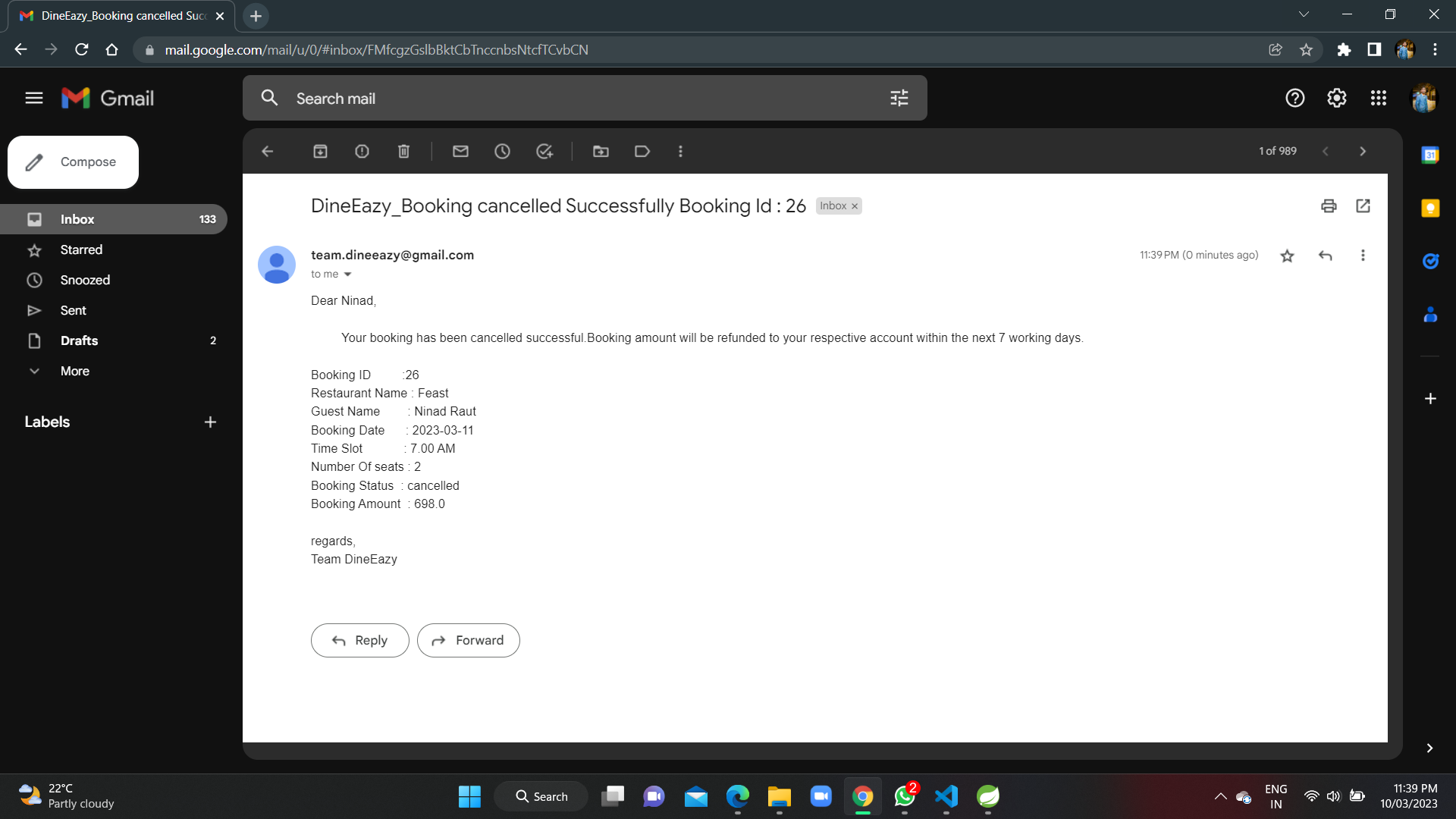

Slide 42


